Slide 1
​THE CORRELATION BETWEEN CHILDHOOD ADVERSITY AND SPECIFICITY OF MURDER IN AMERICAN SERIAL KILLERS ​
​
​
Reeti Patel​

Slide 2
IITRIGGER WARNINGII
IImurder, domestic violence, death, violence, sexualII IIassualt, verbal abuse, physical abuse, sexual abuse,II IIchild abuse, tortureII

Slide 3
Introduction |
Psychopathy
|
Antisocial Personality Disorder
Psychopathy | APD
A mental disorder exhibiting these qualities:​​
​
Lack of empathy
Amoral behavior ​​​​​​
Narcissism ​​
Intelligence

Slide 4
Introduction |
iitw//domestic violenceii
What is an ACE?
Potentially traumatic events that occur in childhood (ages 0-18).
For Example: experiencing or witnessing violence, abuse, neglect etc.
Measured using the Adverse Childhood Experiences Scale (ACE Scale)
Adverse Childhood Experiences

Slide 5
Introduction |
Specificity of Serial
Murder
iitw//murderii
What is Specificity?
How frequently some variable of a serial murder is repeated
Victimology, Modus Operandi, Geography
Measured using the Specificity of Serial Murder Scale (SSM Scale)

Slide 6
Introduction | Male vs Female
iitw//violence, sexual assaultii
Male
Impersonal kills​
Use "messier" methods such as:​
Stabbing​
Beating​
Sexual motive
Female
Personal kills​
Use "cleaner" methods, such as ​
Poison​
Arson​
Financial motive

Slide 7
Literature Review
As adolescent trauma increases, so do psychopathic tendencies.​
Christian, E. J., Meltzer, C. L., Thede, L. L., Kosson, D. S. (2016, March 30). The Relationship Between Early Life Events, Parental Attachment, and Psychopathic Tendencies in Adolescent Detainees. Springer. ​

Slide 8
Literature Review
Different levels of trauma affect males and females differently. Females handle trauma better and express better as well.​
Krischer M, Sevecke K, (2008). Early Traumatization and Psychopathy in Female and Male Juvenile Offenders. Int J Law Psychiatry​

Slide 9
Literature Review
The generally harsher and stricter parenting methods of Hispanic parents may lead to a higher rate of psychopathic tendencies in the Hispanic female population.​
Vitacco, Neumann, Ramos, Roberts (2003) Ineffective Parenting: a Precursor to Psychopathic Traits and Delinquency in Hispanic Females. Ann N Y Acad Sci 1008:300-303​

Slide 10
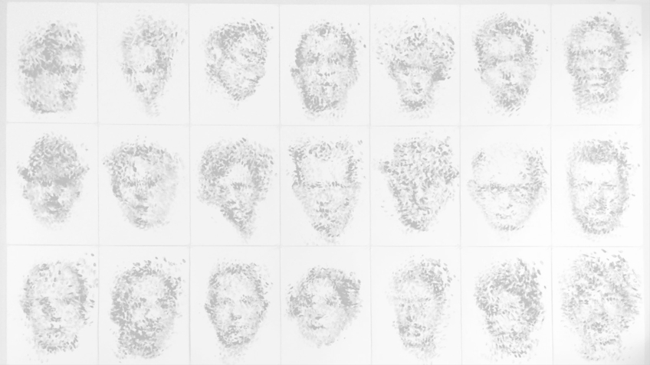
HYPOTHESIS​
iiHypothesis A: Childhood adversity contributes to an increase in specificity inii iia serial crime.ii
iiHypothesis B: If childhood adversity is a contributor to specificity, the rate atii iiwhich specificity increases in male serial killers is greater than the rate ofii iispecificity growth in female serial killers.ii
​
​

Slide 11
Methodology | Participants
Male
40 serial killers
Active in the United States before 2019
At least 5 confirmed victims
Female
20 serial killers
Active in the United States before 2019
At least 2 confirmed victims

Slide 12
Methodology
Measures
ACE Scale
13 questions | 13 points
Can predict future:
Health
Behavior
Developed by Kaiser & CDC

Slide 13
Methodology
Measures
SSM Scale
13 variables | 65 points
Victimology | 5
Modus Operandi | 6
Geography | 2
Developed by Reeti Patel 2019

Slide 14
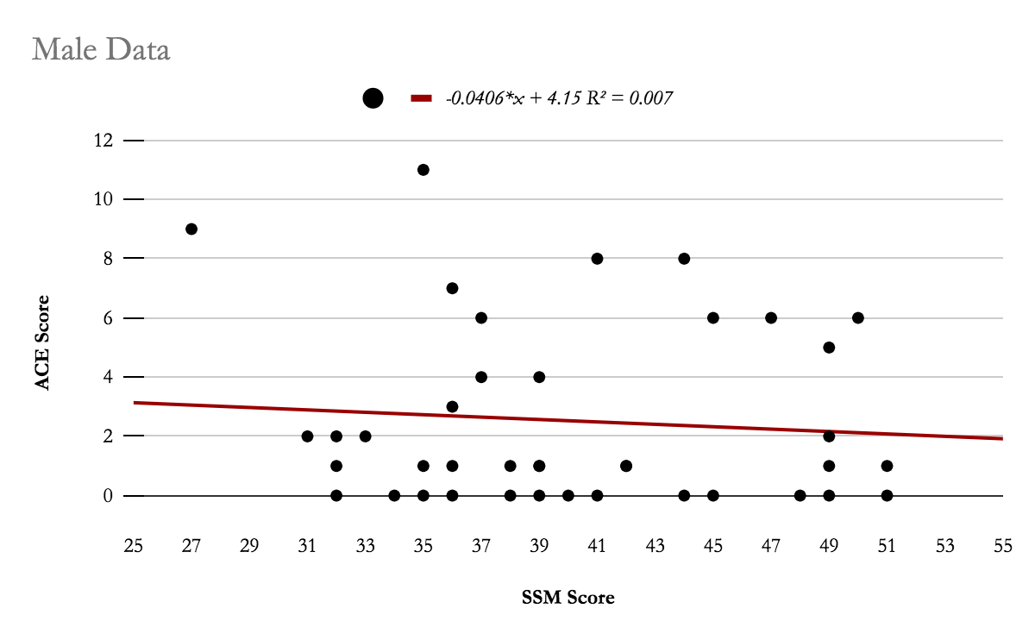
Results | Male
Figure 1: Male ACE and SSM Scores
P = .6035

Slide 15
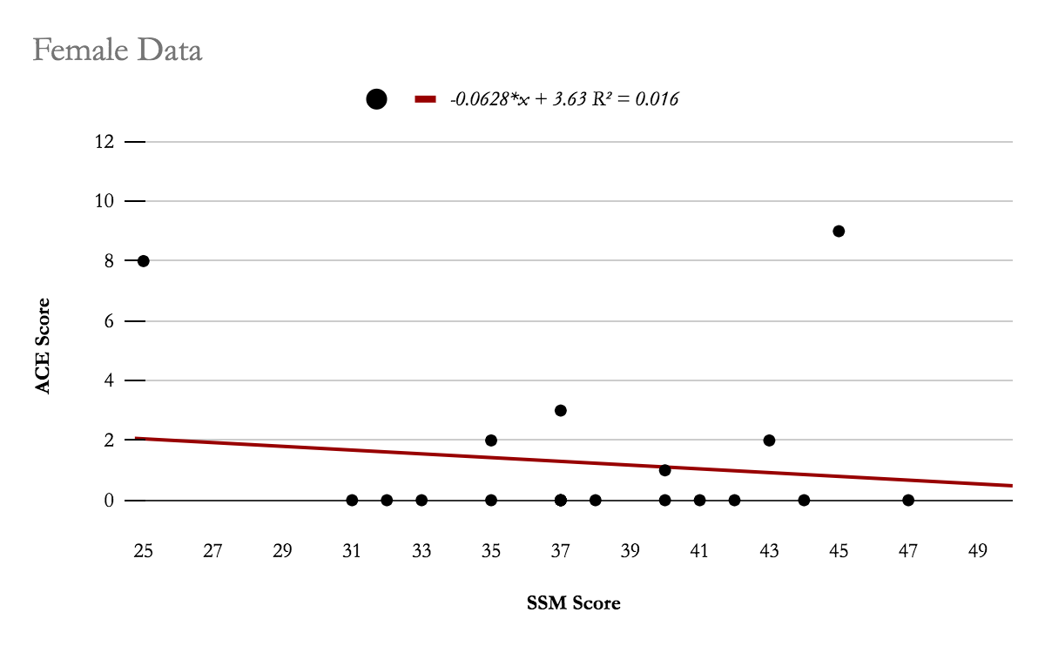
Results | Female
Female Data | Lower End Outlier | Upper End Outlier
SSM | 25i | X
ACE | X | 8 & 9i
Figure 2: Female ACE and SSM Scores
Figure 3: Female Data: Upper and
Lower End Outliers
P = .5982

Slide 16
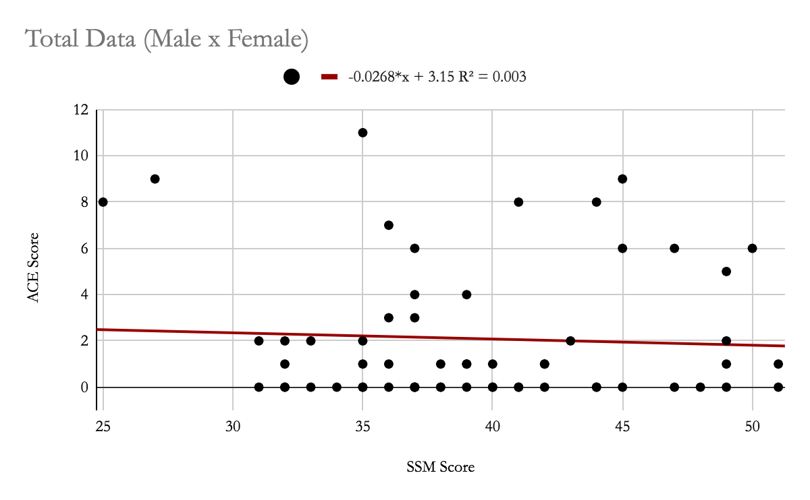
Results | Female and Male
70%
Figure 4: Complete Male and Female ACE and SSM Scores

Slide 17
Results | Frequency of ACE’s
iitw//verbal, physical, sexual abuseii
Figure 5: Most Frequent ACE Q’s (Measured by Number of Yes’)
Figure 5
1a and 1b: verbal abuse
2a: physical abuse
6: relationship status between parents
Figure 6
3a and 3b: sexual abuse
7c: witness to maternal abuse
Q | Total | F|T | M|T | F | M
1a | 22% | 3% | 18.3% | 10% | 27.5%
1b | 20% | 3% | 16.6% | 10% | 25%
2a | 20% | 3% | 16.6% | 10% | 25%
6 | 43% | 10% | 33.3% | 30% | 50%
Figure 6: Least Frequent ACE Q’s (Measured by Number of Yes’)
Q | Total | F|T | M|T | F | M
3a | 6.6% | 1.6% | 5% | 5% | 7.5%
3b | 6.6% | 1.6% | 5% | 5% | 7.5%
7c | 5% | 0% | 5% | 0% | 7.5%

Slide 18
Results | Frequency of SSM Variables
Figure 7: Most Frequent SSM Variables
(Measured by Number of 5’s)
Figure 7
What was the victims sexual orientation?
Victimology
Variable 5
Q | Total | F|T | M|T | F | M
S.O. | 100% | 33.3% | 66.6% | 100% | 100%
Figure 8: Least Frequent SSM Variables
(Measured by Number of 0’s)
Figure 8
Were there any post mortem rituals?
Modus Operandi
Variable 6
Q | Total | F|T | M|T | F | M
P.M. | 91.6% | 33.3% | 58.3% | 100% | 87.5%

Slide 19
Discussion | Outliers
Female Data | Lower Outlier | Score of Outlier | Upper Outlier | Score of Outlier
SSM | 25.25 | 25i | 51.25 | X
ACE | -2.25 | X | 3.75 | 8 & 9i
Female Outliers
3 female outliers (figure 4)
Male data yielded no outliers
Female outliers due to sample size | 20 subjects
Male sample size was double | 40 subjects
Figure 4: Female Data: Upper and
Lower End Outliers

Slide 20
Discussion | Data Clusters
ACE 0-2
Data was collected
No interviews were conducted
SSM 30-50
Serial killers by definition are specific
Linked through M.O.
Without specifics, murders are not classified as serial killers

Slide 21
Discussion | Frequency of ACE’s
iitw//child abuseii
Consistent with previous findings about paternal relationships with psychopathic and violent children
Most psychopaths report abusive parents or guardians
Data from question 6 is also consistent with previous studies
Not all serial killers have seperated parents or have lost a parent
Highly probable that any given serial killer will have seperated parents, a single parent or no parents

Slide 22
Discussion | Frequency of SSM Variables
iitw//tortureii
SSM scores should be regarded with mild skepticism
Data collection
Private information or undisclosed information
victim sexuality
ante | post mortem rituals

Slide 23
Conclusion| Hypothesis Refuted
No significant correlation between ACE and SSM
Unable to determine the significance of hypothesis b because hypothesis a was refuted

Slide 24
Future Work
iitw//child abuseii
Retrial conducted with interviews
Determine correlation between SSM score and specific types of childhood adversity
i.e. SSM score will increase as years spent with a physically abusive parent increases.

Slide 25
References
Hickey, 1991
Harrison, M.A., Hughes, S.M., & Gott, A.J. (2019, January 24). Sex Differences in Serial Killers. Evolutionary Behavioral Sciences. Advance Online Publication. http://dx.doi.org/10.1037/ebs0000157
FBI Expanded Homicide Data USA, 2018
Christian, E. J., Meltzer, C. L., Thede, L. L., Kosson, D. S. (2016, March 30). The Relationship Between Early Life Events, Parental Attachment, and Psychopathic Tendencies in Adolescent Detainees. Springer. ​
Vitacco, Neumann, Ramos, Roberts (2003) Ineffective Parenting: a Precursor to Psychopathic Traits and Delinquency in Hispanic Females. Ann N Y Acad Sci 1008:300-303​
Krischer M, Sevecke K, (2008). Early Traumatization and Psychopathy in Female and Male Juvenile Offenders. Int J Law Psychiatry
Farrell, A., & Bruce, S. (1997). Impact of exposure to community violence on violent behavior and emotional distress among urban adolescents. Journal of Clinical Child Psychology, 26, 2–14.
Galler, J., Bryce, C., Waber, D., Hock, R., Exner, N., Eaglesfield, D., Fitzmaurice, G. and Harrison, R. (2010), Early childhood malnutrition predicts depressive symptoms at ages 11–17. Journal of Child Psychology and Psychiatry, 51: 789-798. https://doi.org/10.1111/j.1469-7610.2010.02208.x
Keeney, B. T., & Heide, K. M. (1994). Gender Differences in Serial Murderers: A Preliminary Analysis. Journal of Interpersonal Violence, 9(3), 383–398. https://doi.org/10.1177/088626094009003007
Merriam-Webster, (2020). Specificity
Patel R., (2019). Specificity of Serial Murder Scale

Slide 26
Acknowledgments | a special thanks to...
Dr. Amy Nitza
Mr. Matthew Paley
Mr. Justin Seweryn
Science Research Peers

